Slide 1


Midpoint Presentation
Group V
Brain Training Apps Limited

Slide 2

Business Idea
'Brain Training' game for children
Different categories of questions & quizzes
Users results and progress is stored on their profile
Extra categories of questions can be bought and added to the game
Coded with Unity (Previously Android Studio)
Players awarded points for answering questions correctly

Slide 3

Our Influences
Influenced by brain training games for the Nintendo DS
These games spiked in popularity in the mid-2000s
Surpassed retailers' expectations on how well educational games would sell
Performed very well internationally
Big Brain Academy and Brain Age sold over 10 million copies each

Slide 4
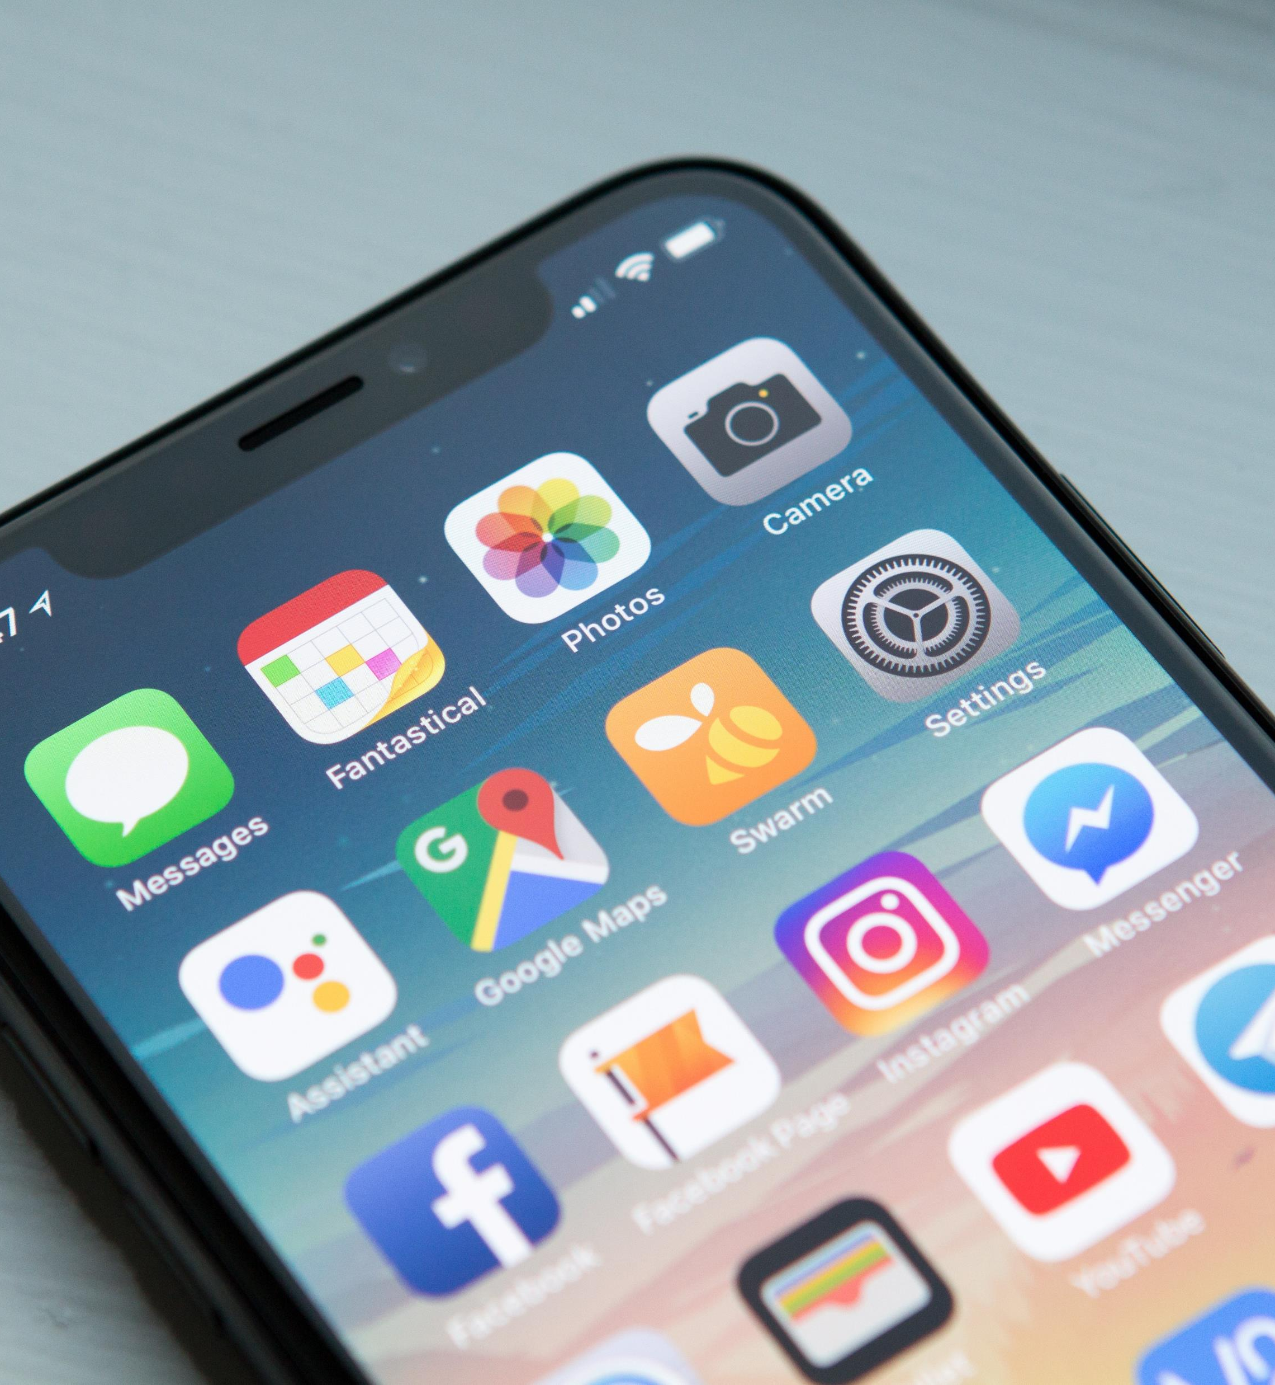
Our Market : Market size
Target market is children between the ages of 8 and 12
As we saw in the previous slides there was a very big market for brain training games, but is that the same today?

Slide 5
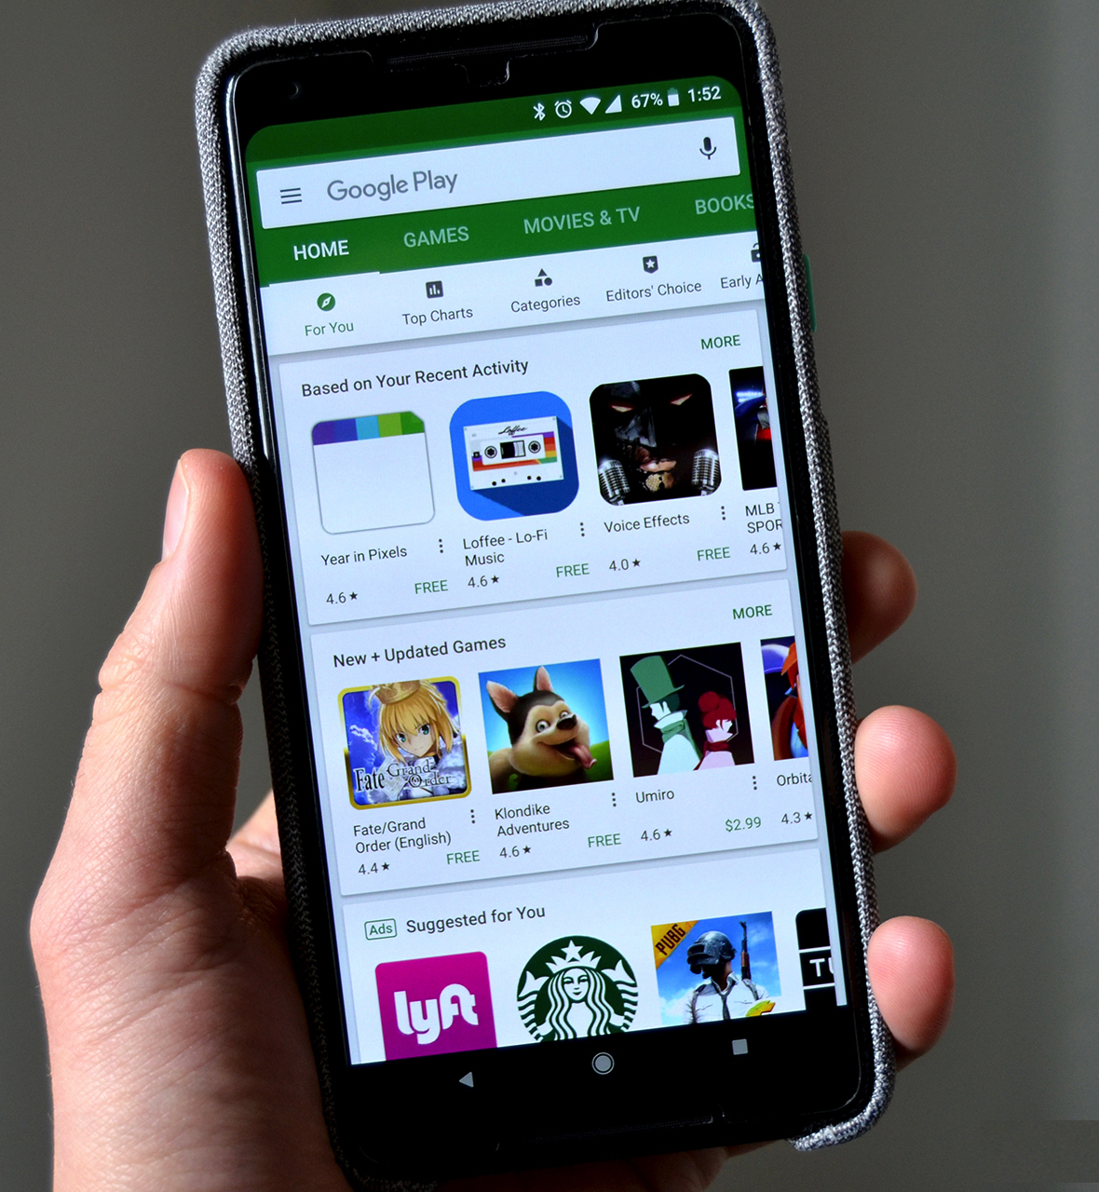
Our Market : Market size
There are at least 5 major mobile brain training games on the google play store with over 10 million downloads each
Plenty with between 1-5 million + downloads
There are an estimated 2.3 billion android users in the world
However, from checking the Google Play store it is quite clear most of these games are targeted for adults

Slide 6

Pricing
Huge usage of third-party advertisements
All the top brain training games advertise themselves as free but have a large portion of their content locked behind a paywall
We believe both are a mistake
We plan on making money off our application by having extra categories of questions for sale however most of the game will be free

Slide 7
Distribution
In order to put the app on the Google Play Store there is a small onetime fee of 25 dollars
Our game will be in direct competition with the already well-established games
Find flaws and ways to be better than the competition

Slide 8

Flaws of other Brain Training Games
Advertisements
Free game are of poor quality and paid games have many hidden purchases
Repetitive styles of questions and quizzes

Slide 9
Distribution
Our game will embody features that make it fun to use for children
It will be advertised to parents as an educational application
Will offer the ability to show child's process and length of time playing the game
Will be free to download and offer in-app purchases

Slide 10
Distribution
Our survey results suggested the biggest influence would be the school endorsing the application
We plan to go to the primary schools that team members attended and ask for their support
Following on from that we will use Facebook to create advertisements specifically targeted to parents
We will advertise towards parents as they will fund their child's applications

Slide 11
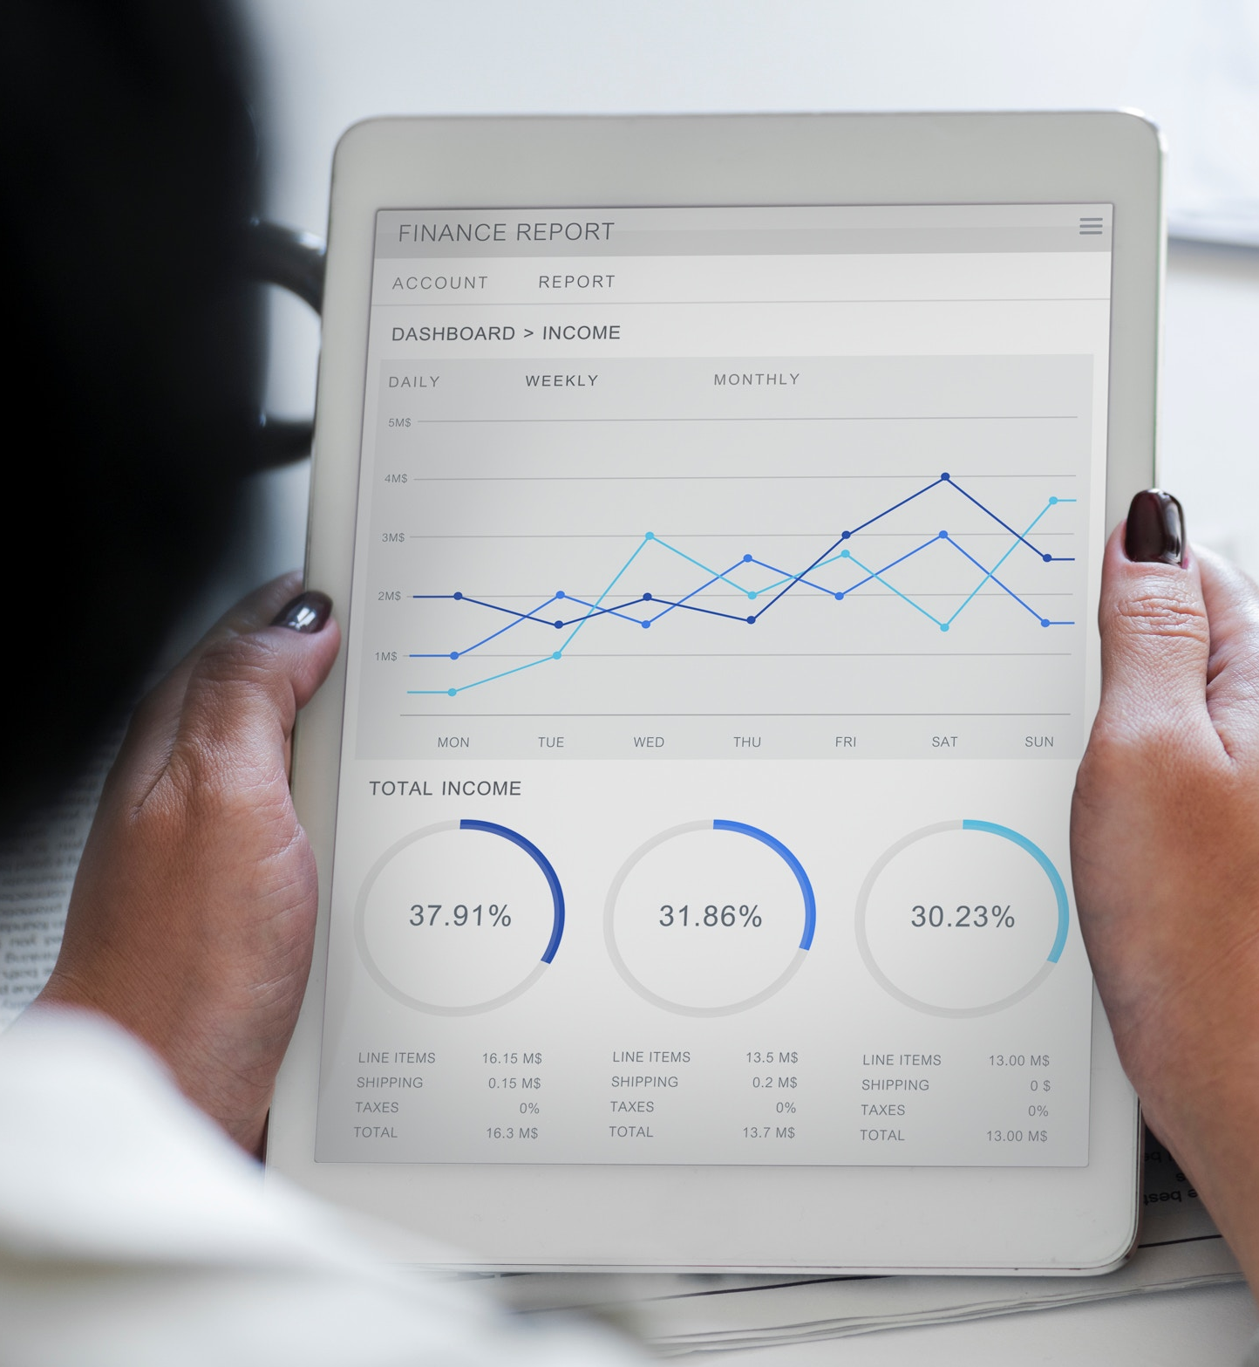
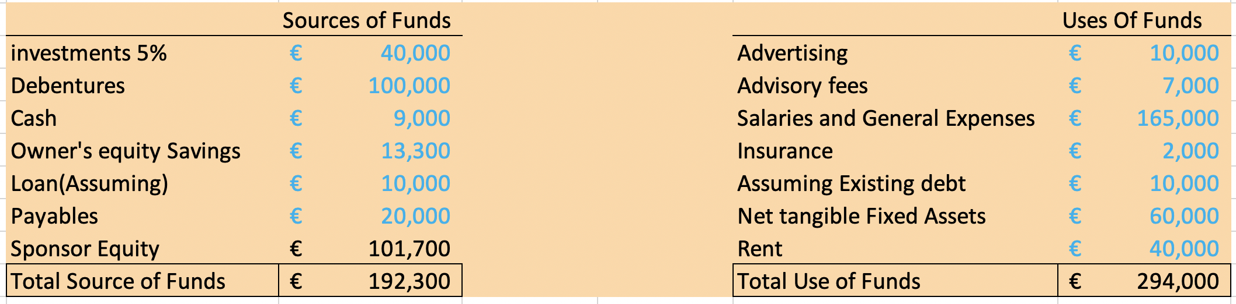
Financial Summary
Income will be sourced from Founders and Family,
Expenditure: Fixed Assets, Salaries and Advertising

Slide 12

Operation Management
We used Trello and Microsoft Project to organise what work each team member does.
We found Unity more suitable to our project
As a result we had to scrap the previous progress on Android Studio which sets us back for a small period.
We all had to learn how to use Unity. This application has a much better functionality for making games.

Slide 13
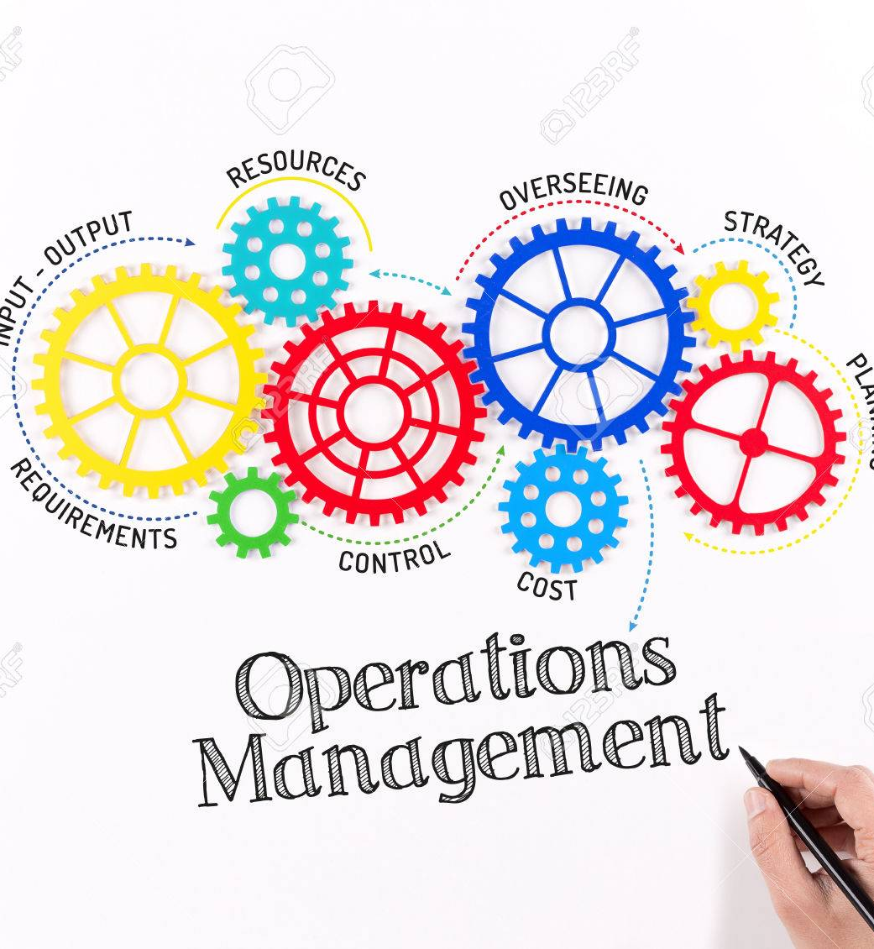
Operation Management
In order to keep each other up to date with our progress we had weekly meetings.
With the aid of project management software every group member knew what tasks for the project they had to do.

Slide 14
Management Team
Abigail Boyle: Project Manager/Math's Game
Wiktor Wolsza: Word Definition Game
Roberto Niculita:Observation Game
Tijesu Olalekan: Memory Game
Luke Sheehan: Pattern Game

Slide 15
Abigail Boyle
Management of Trello page
Research User Requirements
Creating a math's game for our application
Created a survey for market research

Slide 16
Wiktor Wolsza
Completed research into our market
Creating a word definition game
Found non-functional requirements
Updating our Trello page

Slide 17
Tijesu Olalekan
Creating a memory game
Finance
Updating our Trello Page

Slide 18
Luke Sheehan
Functional Requirements
Use Cases
Patterns Game
Functionality of application

Slide 19
Roberto Niculita
GUI design
Creating an observation game
UML diagram

Slide 20

Technologies/Software/Tools Used
For the development of our application we used Unity
For project management we used tools such as: Microsoft Project, Trello, GitHub, Google Docs, PowerPoint online

Slide 21
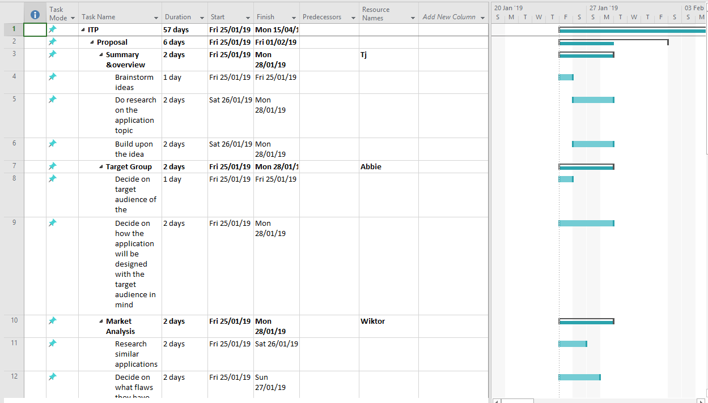
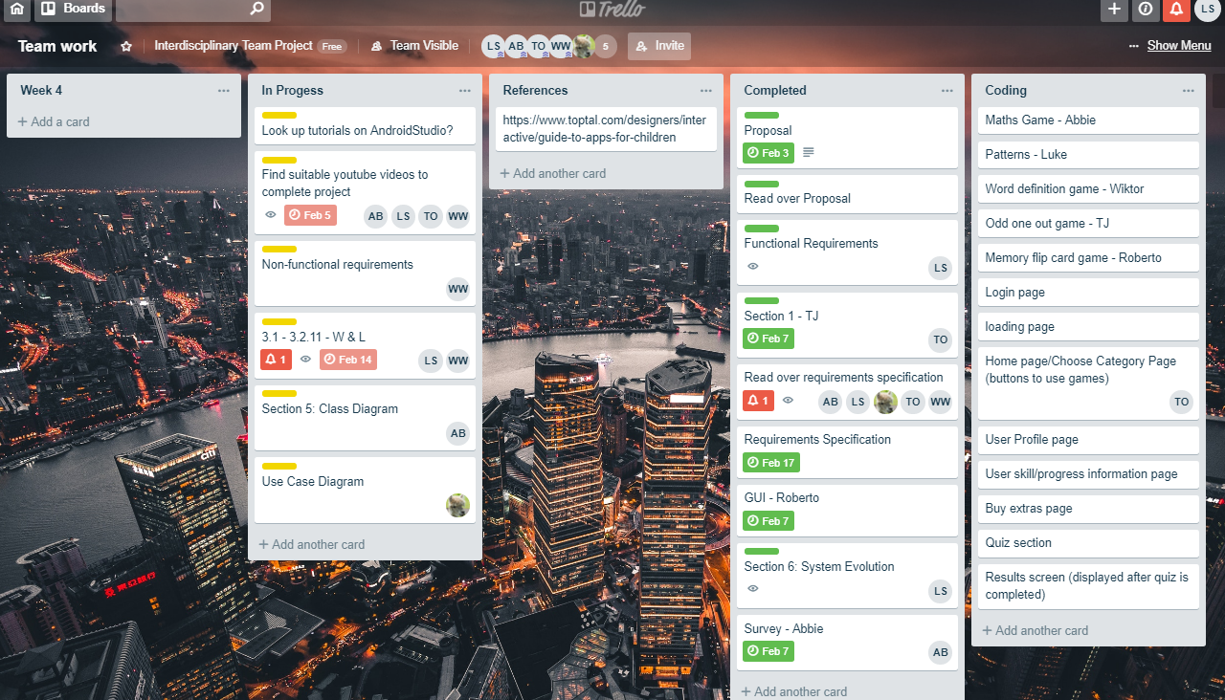
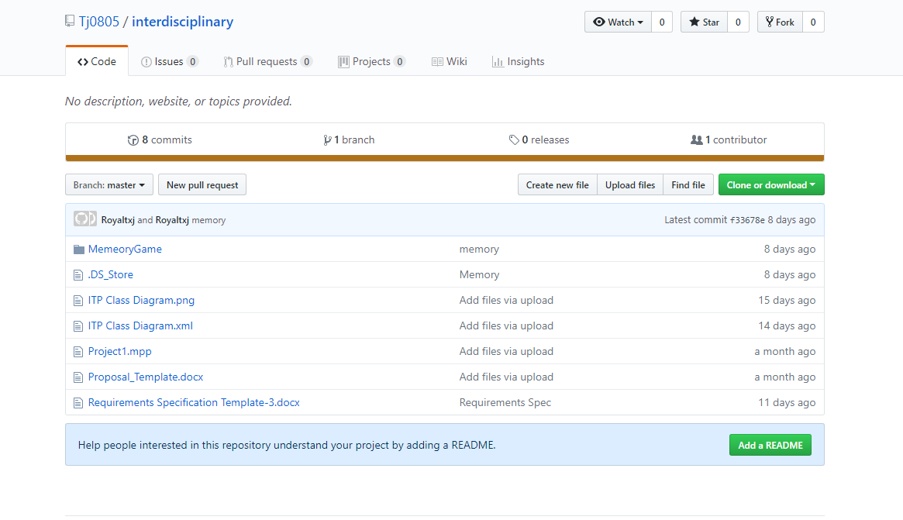
Microsoft Project
Trello
GitHub

Slide 22

Challenges Faced/Conclusion
Deciding on the best software to create our application with
Dividing the work load equally among the team members
Deciding on a non-advertisement way of making the application monetizable
Project management software such as Trello and Microsoft Project helped organize and schedule the work-load

Slide 23

Questions?

